Slide 1

FAMILY TIME
Permanency, Prevention and Well-Being

Slide 2


In the past, children often went weeks or months without seeing their parents after removal, delays that contributed to trauma and poor case outcomes.

Slide 3
Family Time Promotes And Supports
Case progression toward reunification and permanency
Building Hope
Opportunities to observe parent-child interactions
Assessment of parental behavior change over time
Opportunities for real-time coaching and feedback
Beginning with the least restrictive supervision level

Slide 4
Research shows that when children have frequent Family Time with their parents, they experience significantly better outcomes across several domains:
Emotional and Behavioral Well-Being
Permanency Outcomes
Support for Parents and Caregivers
Hope and Connection
Family Time Research

Slide 5

Emotional and Behavioral Well-Being
Fewer behavioral challenges while in out-of-home care
Reduced anxiety and depression
Greater ability to adjust and settle in placement
Strengthened sense of identity and connection to family, culture, and community

Slide 6
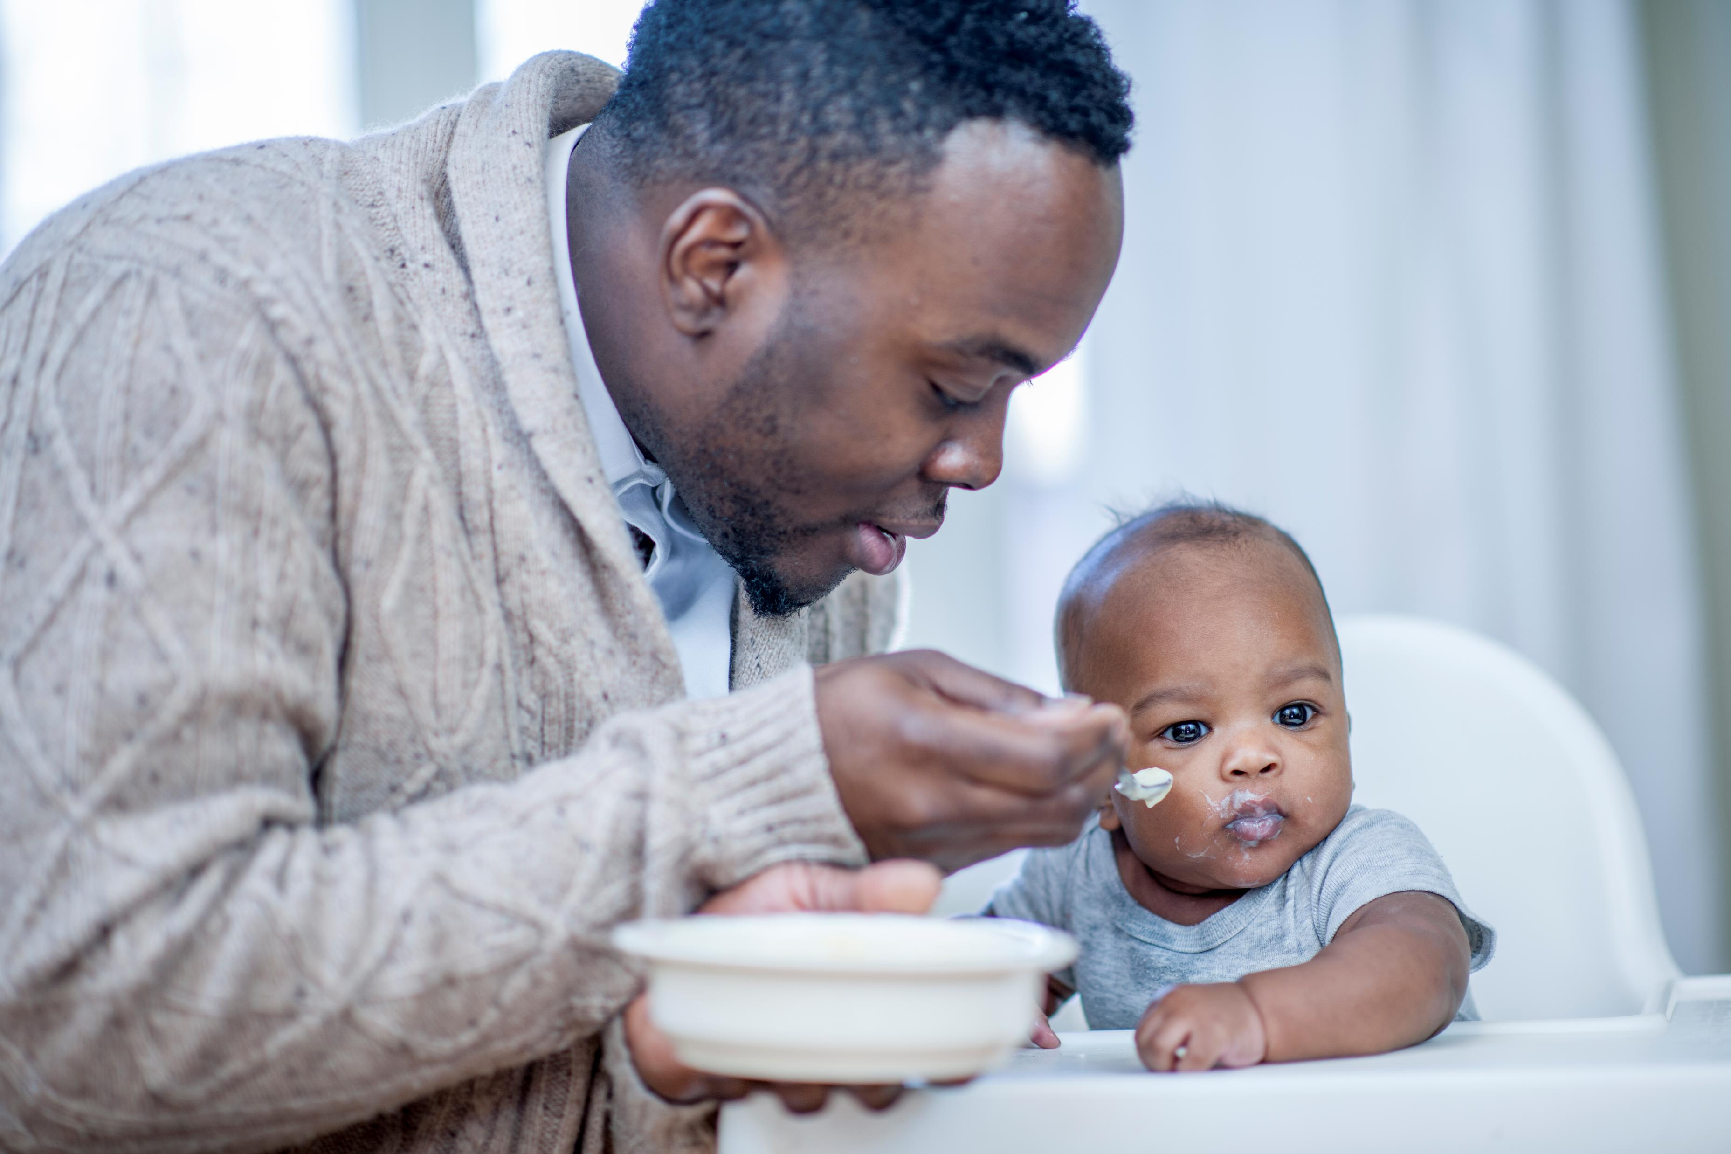
Permanency Outcomes
Children who had frequent contact with their parents (once a week or once every two weeks)
exhibited fewer behavioral problems
showed less anxiety and depression
Cantos, A. L., Gries, L. T., & Slis, V. (1997). Behavioral correlates of parental visiting during family foster care. Child Welfare: Journal of Policy, Practice, and Program, 76(2), 309–329.

Slide 7
Permanency Outcomes
Children with frequent contact with their parents:
have higher well-being ratings
adjust better to placement
more likely to reunify with family
experience shorter stays in foster care
Hess, Peg McCartt,( 2003) Family Visitation Between Children in Care and Their Families: A look at Current Policy. New York: The National Resource Center for Family-Centered Practice and Permanency Planning, Hunter College School of Social Work. www.hunter.cny.edu/socwork/nrcfcpp.

Slide 8
Permanency Outcomes
Children in foster care who saw their parents less than once a month felt they suffered as a result of not maintaining contact with their birth parents.
Kufeldt,K & Armstrong,J.,( 1995). How Children in Care View Their Own and Their Foster Families: A Research Study. Child Welfare, 74 (3),pgs.695-716.

Slide 9

Support for Parents and Caregivers
Encourages parents to remain engaged and committed to addressing safety concerns
Creates more opportunities for coaching and skill-building during visits
Allows foster parents and staff to provide feedback and support to parents in real-time

Slide 10

Hope and Connection
Frequent FT builds and sustains hope—for both children and parents
Helps ease children’s fears about their parents’ well-being
Reinforces the parent-child bond and motivates continued progress

Slide 11
FT is a right of the child, not a privilege for the parent.
FT is tied only to the child’s safety, it cannot be used as a punitive measure against a parent.
FT supervision level or frequency can be adjusted if the CW specialist or the court assess it is necessary for the child’s safety.
Family Time Rights

Slide 12
Family Time Plan Timeframes
Child Protective Services (CPS)
Best practice for recommended first family time is 48 hours after removal,
Psychologists found all children benefit from seeing their families just 48 hours after removal as this helps to reduce trauma and build hope
7 calendar days after removal is the expectation in child welfare policy

Slide 13
Family Time Plan Timeframes
Permanency Planning
Within 10 days of removal the family time plan form must be completed – may be done by either CPS or Permanency
Within one month after removal a sibling family time is expected to be scheduled and documented

Slide 14
Family Time Plan Timeframes
Permanency Planning
Every 30 days the Family Time Plan is reviewed
Family time plans are to be reviewed and updated as the case progresses
Allows for moving to less restrictive level of supervision as parents progress

Slide 15

Levels Of Supervision In Family Time
Unsupervised: least restrictive
Monitored
Observed
Supervised
Therapeutic: most restrictive

Slide 16
UNSUPERVISED
Parent and child spend time together without a monitor present, may range from an hour to an overnight visit.
Judicial Considerations:
How long has the Unsupervised been occurring?
What are the next steps to move towards TR?

Slide 17
MONITORED
A monitor provides intermittent contact during FT to ensure the plan is followed. DHS or the approved monitor will be present for part – but not all – of the visit.
Judicial Considerations:
What safety concerns require partial monitoring?
Is there a clear plan to move to unsupervised?

Slide 18
OBSERVED
Monitor is close enough to observe the parent and child but is not required to hear everything said. Parent may have some time alone with child if safety is ensured (i.e. bathroom trips)
Judicial Considerations:
What safety concerns requires observed monitoring?
What conditions prevent moving to monitored?

Slide 19
SUPERVISED
Monitor is in the same room with parent and child, able to see and hear everything. Used when close oversight is needed to ensure the child’s safety and adherence to the FT plan.
Judicial Considerations:
What is the safety concern requiring supervised monitoring?
What are the goals for parent to move to observed?

Slide 20
THERAPEUTIC
FT is supervised by a professional with clinical expertise. Used when mental health concerns, behavioral health needs, or safety risks require therapeutic intervention.
Judicial Considerations:
What interventions are in place to support moving to supervised?
Is the parent actively engaging in therapeutic process?

Slide 21
The Family Time Bench Card
Supports active monitoring and promoting progress in FT in all hearings
Enhances court oversight
Improves communication between parties
Ensures FT remains child-centered, safe, and purposeful
Encourages purposeful questions that drives case progress

Slide 22
The Family Time Bench Card
Reinforces FT as a right of the child tied only to safety
Helps court and DHS align on expectations and timelines
Helps judges assess if FT is progressing safely
Identify what may be preventing progress and whether necessary supports are in place
Align hearing discussion with DHS policy and best practice

Slide 23

Family Time General Prompts
To support judicial oversight of Family Time, we developed a set of practice, case-driven prompts. The prompts on the bench card are designed to guide meaningful, actionable conversations during court hearings about Family Time at any supervision level.

Slide 24
Prompts help identify:
Why the current level is in place
What supports are being provided
Whether parents understand expectations
What next steps are needed before the next hearing
Prompts can be used regardless of whether the family is moving forward, holding steady, or revisiting a previous supervision level.

Slide 25
FT should be planned, purposeful, and progressive
Planned: scheduled
Purposeful: what is the goal of each FT
Progressive: moving to least restrictive and increase in frequency/duration
When safe to do so, FT should be in the parent’s home for best observation of the family
Family Time Best Practices

Slide 26

Progress is Not Always a Straight Line
Family Time should be guided by a clear plan to move toward less supervision as safety and stability increase — but that progression may not always follow a straight path. Children and families may move forward, pause, or revisit previous levels of supervision depending on a variety of factors such as…

Slide 27
Progress is Not Always a Straight Line
Factors to progress:
The child’s emotional and developmental needs
New or ongoing safety concerns
Shifts in parent behavior, stability, or engagement
Availability of supports, coaching, or services
Family dynamics, placement changes, or external stressors

Slide 28
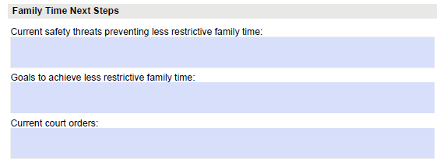
Family Time Form
Notes:
Family Time Next Steps provides an updated status on where the family is in relation to FT. Both Current safety threats preventing less restrictive family time and Goals to achieve less restrictive family time, should have clear specific details that together create a clear pathway to less restrictive FT.

Slide 29

Judicial Role in FT Oversight
Progression based on child safety and revisited frequently
Supervision levels are a path not a ladder
Bench card is a tool designed to:
Promote consistency across courtrooms
Strengthen judicial inquiry
Protect children’s rights to connection
Be a flexible guide, not a script, to support better outcomes for families

Slide 30
THANK YOU
Permanency, Prevention and Well-Being

